Slide 1


PRESENTATION WEB ANALYTICS

Slide 2





Members of GROUP 6:
Phan Dương Giác Ngạn - 19110096
Nguyễn Phan Anh Thiện - 19110149
Lê Ngọc Mẫn - 19110092
Phan Ngọc Nhật Huy - 19110082
Trần Văn Thiên - 19110136

Slide 3
01
02
03
04
05
06
CONTENT OF THE PRESENTATION
CONCEPTS AND METHODS
KPIs
CONVERSION AND ROI
AB/ MULTIVARIATE TESTING
SITEMAP
GOOGLE ANALYTICS

Slide 4
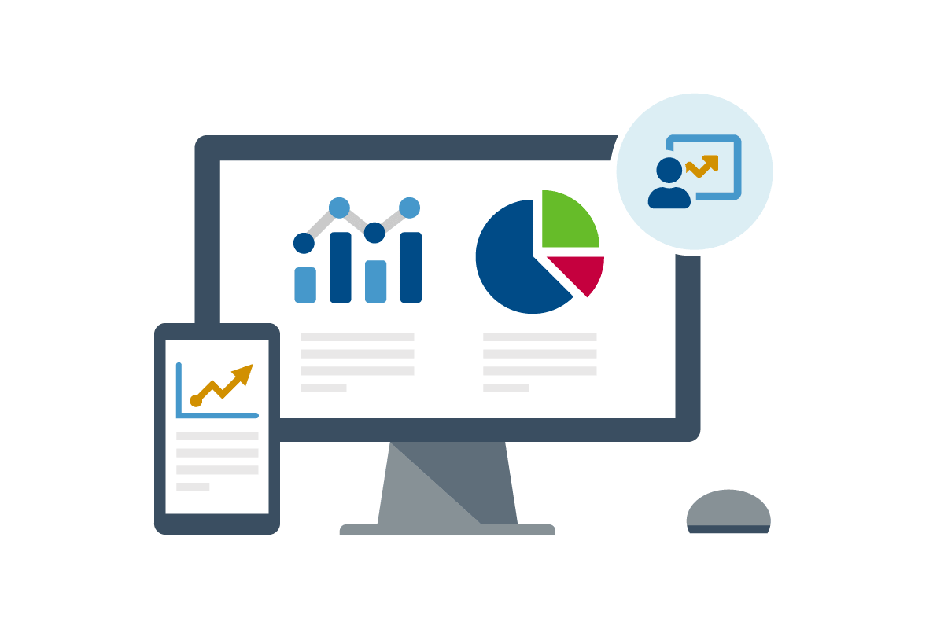
01
CONCEPTS AND METHODS

Slide 5
WHAT IS WEB ANALYTICS?
Web Analytics is the methodological study of online/offline patterns and trends.

Slide 6
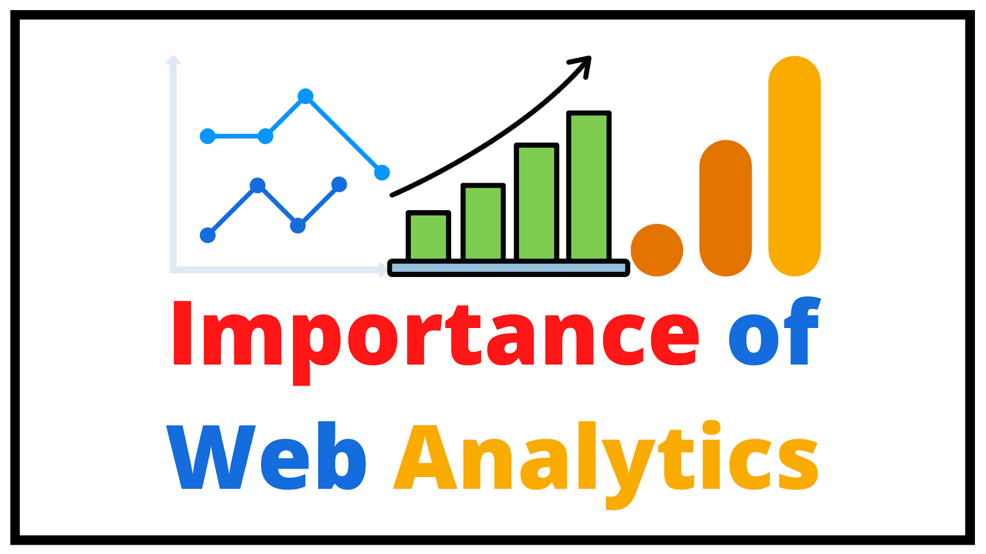
We need Web Analytics to assess the success rate of a website and its associated business.
IMPORTANCE OF WEB ANALYTICS

Slide 7
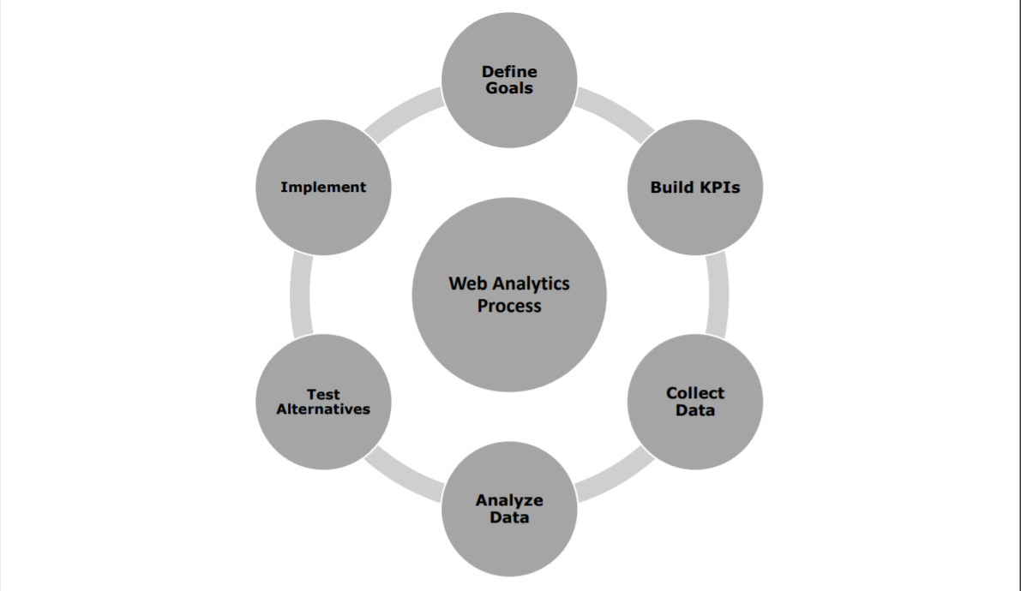
WEB ANALYTICS PROCESS

Slide 8
WEB ANALYTICS METHOD
01
03
Cookies
Mobile phone tracking
02
04
Geotargeting
Geotagging

Slide 9

02
KPIs

Slide 10
A key performance indicator (KPI) is a quantifiable measurement or data point used to gauge performance relative to some goal.

Slide 11

WHY ARE KEY PERFORMANCE INDICATORS IMPORTANT?
KPIs are important just like strategy and goal setting are important. Without KPIs, it’s difficult to gauge progress over time.
KPIs tell you more information about your business and your customers, so you can make informed and strategic decisions.

Slide 12
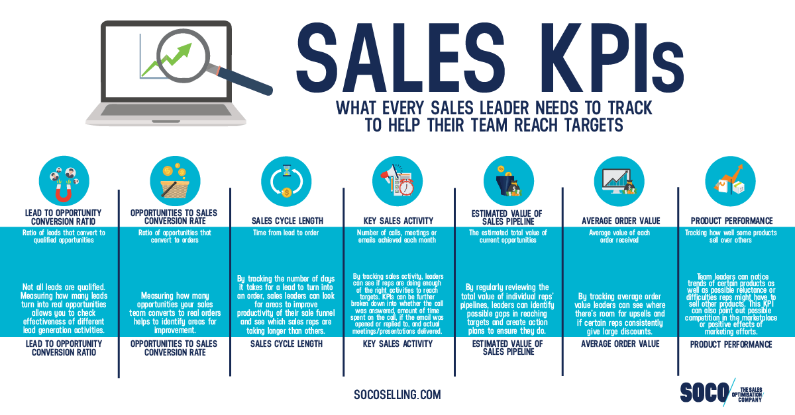
TYPES OF KEY PERFORMANCE INDICATORS FOR E-COMMERCE
SALES
- Sales key performance indicators are measures that tell you how your business is doing in terms of conversions and revenue. You can look at sales KPIs related to a specific channel, time period, team, employee, etc. to inform business decisions.

Slide 13
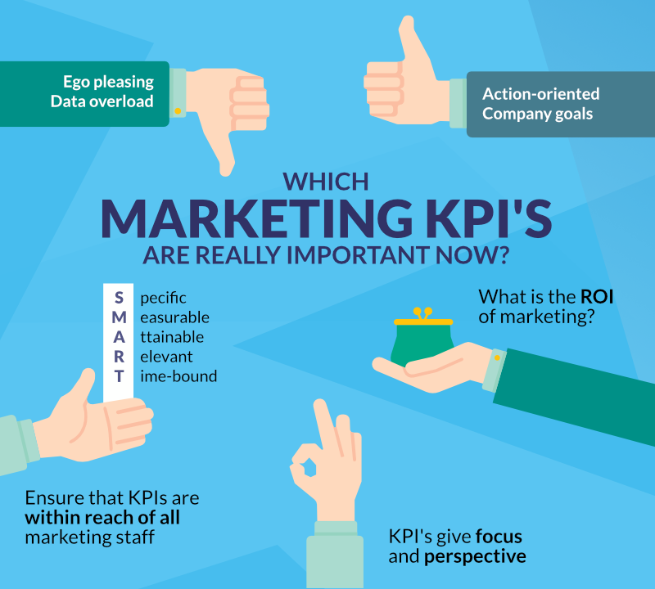
TYPES OF KEY PERFORMANCE INDICATORS FOR E-COMMERCE
2. MARKETING
- Key performance indicators for marketing tell you how well you’re doing in relation to your marketing and advertising goals.
Marketers use KPIs to understand which products are selling, who’s buying them, how they’re buying them, and why they’re buying them.

Slide 14
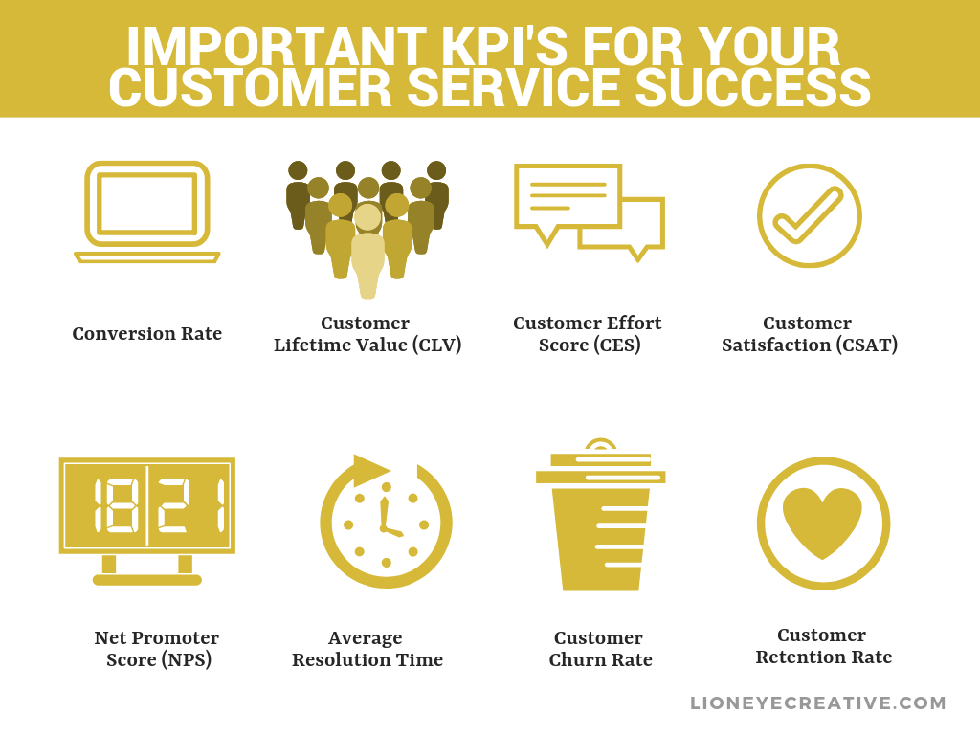
TYPES OF KEY PERFORMANCE INDICATORS FOR E-COMMERCE
3. CUSTOMER SERVICE
- Customer service KPIs tell you how effective your customer service is and if you’re meeting expectations. This KPIs KPIs will help you ensure you’re providing a positive customer experience.

Slide 15

TYPES OF KEY PERFORMANCE INDICATORS FOR E-COMMERCE
4. MANUFACTURING
- Key performance indicators for manufacturing are, predictably, related to your supply chain, production processes, where efficiencies and inefficiencies are, as well as help you understand productivity and expenses.

Slide 16
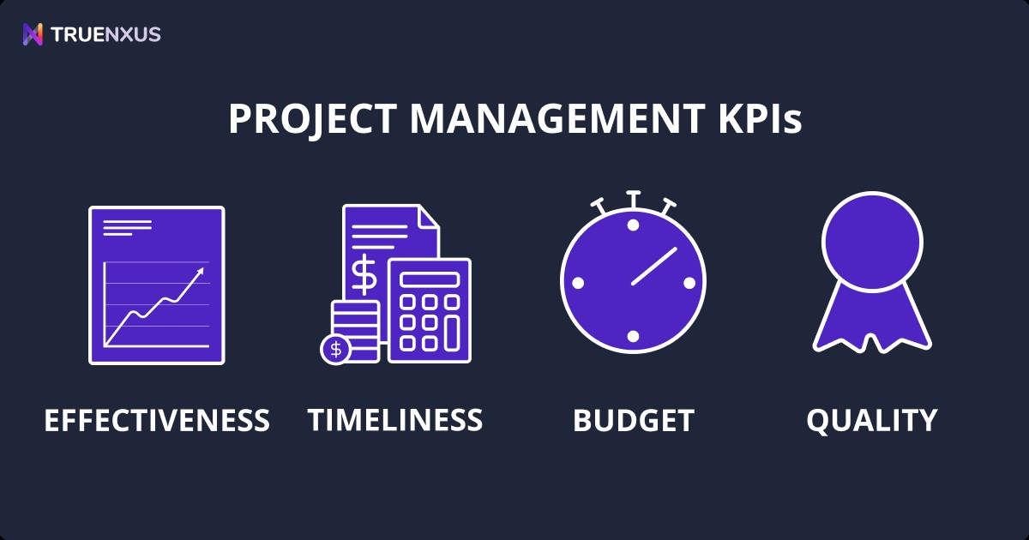
TYPES OF KEY PERFORMANCE INDICATORS FOR E-COMMERCE
5. PROJECT MANAGEMENT
- KPIs to measure effectiveness for managing a project provide managers with an accurate view of the performance and progress of tasks, progress towards completing the goals of a project.

Slide 17
HOW TO CREATE KPI?
Selecting your KPIs begins with clearly stating your goals and understanding which areas of business impact those goals. Of course, KPIs for ecommerce can and should differ for each of your goals, whether they’re related to boosting sales, streamlining marketing, or improving customer service.

Slide 18

03
CONVERSION AND ROI

Slide 19
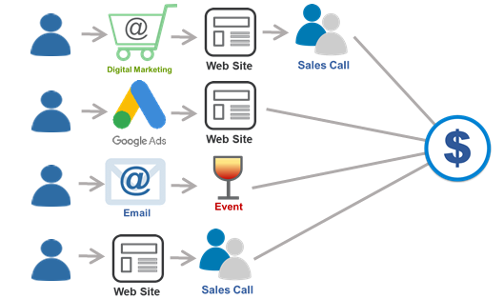
WHAT IS CONVERSION?
Conversion rate is the percentage of visitors to your website that complete a desired goal (a conversion) out of the total number of visitors.

Slide 20
01
02
03
04
05
06
A FEW COMMON TYPES OF CONVERSIONS
Making a purchase
Submitting a form
Calling your business
Engaging with your online chat
Signing up for a subscription
Registering on the site

Slide 21
HOW TO CALCULATE CONVERSION RATE?
Divide the number of conversions you get in a given time frame by the total number of people who visited your site or landing page and multiply it by 100%.

Slide 22
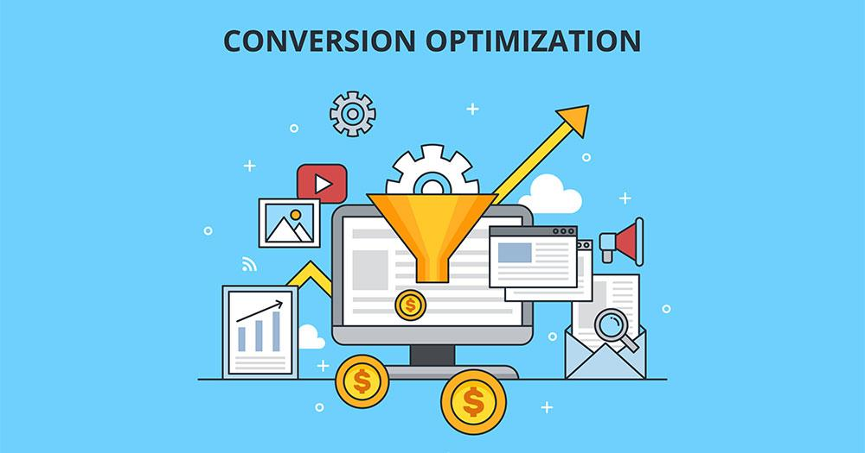
Regular monitoring of the conversion rate will let you know the performance of your website or trading application, capture the user rate, allow you to make the most objective assessment of the success of the website.
THE IMPORTANCE OF CONVERSION RATE (CR)

Slide 23
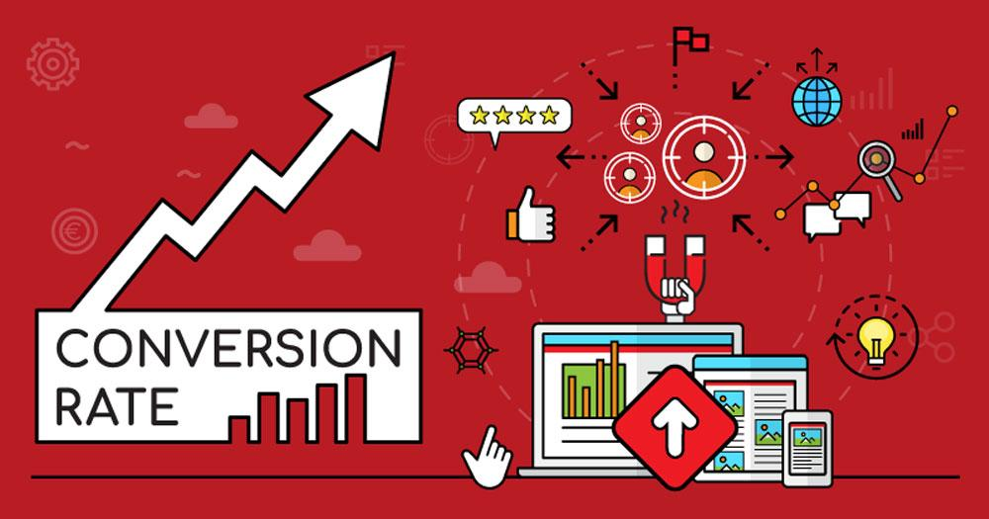
HOW TO INCREASE WEBSITE CONVERSION RATE?
Page loading speed: Improve website speed
Optimize interface

Slide 24

Return on investment (ROI) or return on costs (ROC) is a ratio between net income (over a period) and investment (costs resulting from an investment of some resources at a point in time).
WHAT IS ROI?

Slide 25

MEANING OF ROI
- ROI is a parameter that helps companies realize the importance of marketing or to be more precise, online marketing.

Slide 26
WHAT IS THE FORMULA FOR CALCULATING RETURN ON INVESTMENT?
Return on investment (%) = (current value of investment if not exited yet or sold price of investment if exited + income from investment − initial investment and other expenses) / initial investment and other expenses x 100%.

Slide 27
EXAMPLE 1:
You bought 1 share of stock for 100 USD and paid buying commission of 5 USD. Then over a year you received 4 USD of dividends and sold the share 1 year after you bought it for 200 USD paying 5 USD selling commission.
Solution:
Your ROI is the following:
ROI = (200 + 4 - 100 - 5 - 5) / (100 + 5 + 5) x 100% = 85.45%
As the duration of this investment is 1 year, this ROI is annual.

Slide 28
EXAMPLE 2:
An investor purchases property A, which is valued at $500,000. Two years later, the investor sells the property for $1,000,000.
Solution:
We use the investment gain formula in this case.
ROI = (1,000,000 – 500,000) / (500,000) = 1 or 100%

Slide 29
As mentioned above, one of the drawbacks of the traditional return on investment metric is that it doesn’t take into account time periods.
ANNUALIZED ROI FORMULA

Slide 30
ADVANTAGES AND DISADVANTAGES OF ROI
01
ADVANTAGES
02
DISADVANTAGES

Slide 31
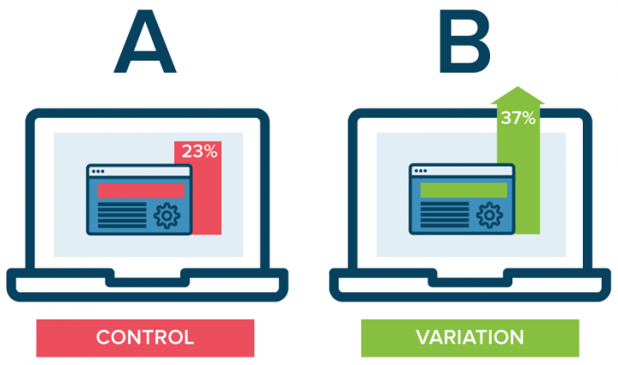
04
AB/ MULTIVARIATE TESTING

Slide 32
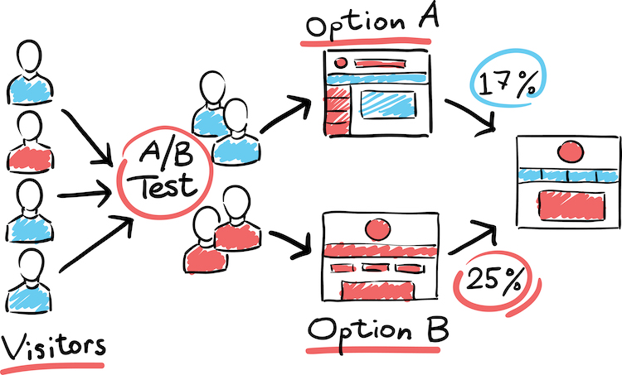
WHAT IS A/B TESTING?
A/B testing (also known as split testing or bucket testing) is a method of comparing two versions of a webpage or app against each other to determine which one performs better.

Slide 33
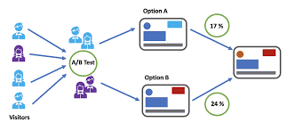
HOW A/B TESTING WORK?
- In order to perform effective tests, you need a “hypothesis”, a way to edit your site, and a tool to record the results. Your hypothesis is simply your idea about how to improve your webpage. This might be changing the location of a call-to-action, the layout of a page, or even the colour of a button.

Slide 34
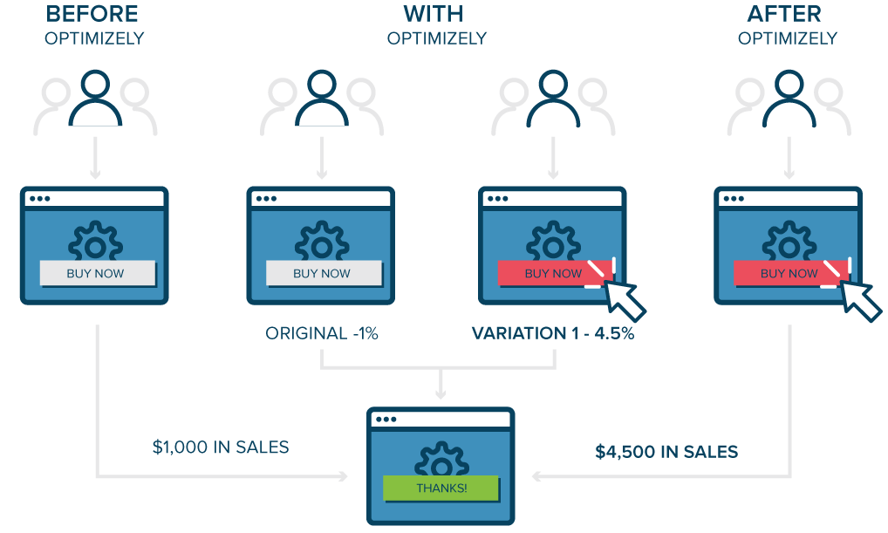
WHY TO USE A/B TESTING?
- A/B testing allows individuals, teams and companies to make careful changes to their user experiences while collecting data on the results. This allows them to construct hypotheses and to learn why certain elements of their experiences impact user behavior. In another way, they can be proven wrong—their opinion about the best experience for a given goal can be proven wrong through an A/B test.

Slide 35
01
02
03
04
05
06
A/B TESTING PROCESS
01
Collect data
Identify goals
Generate hypothesis
Create variations
Run experiment
Analyze results

Slide 36
ADVANTAGES AND DISADVANTAGES
ADVANTAGES
Simple in concept and design, A/B testing is a powerful and widely used testing method.
DISADVANTAGES
A/B testing is a versatile tool, and when paired with smart experiment design and a commitment to iterative cycles of testing and redesign, it can help you make huge improvements to your site.

Slide 37
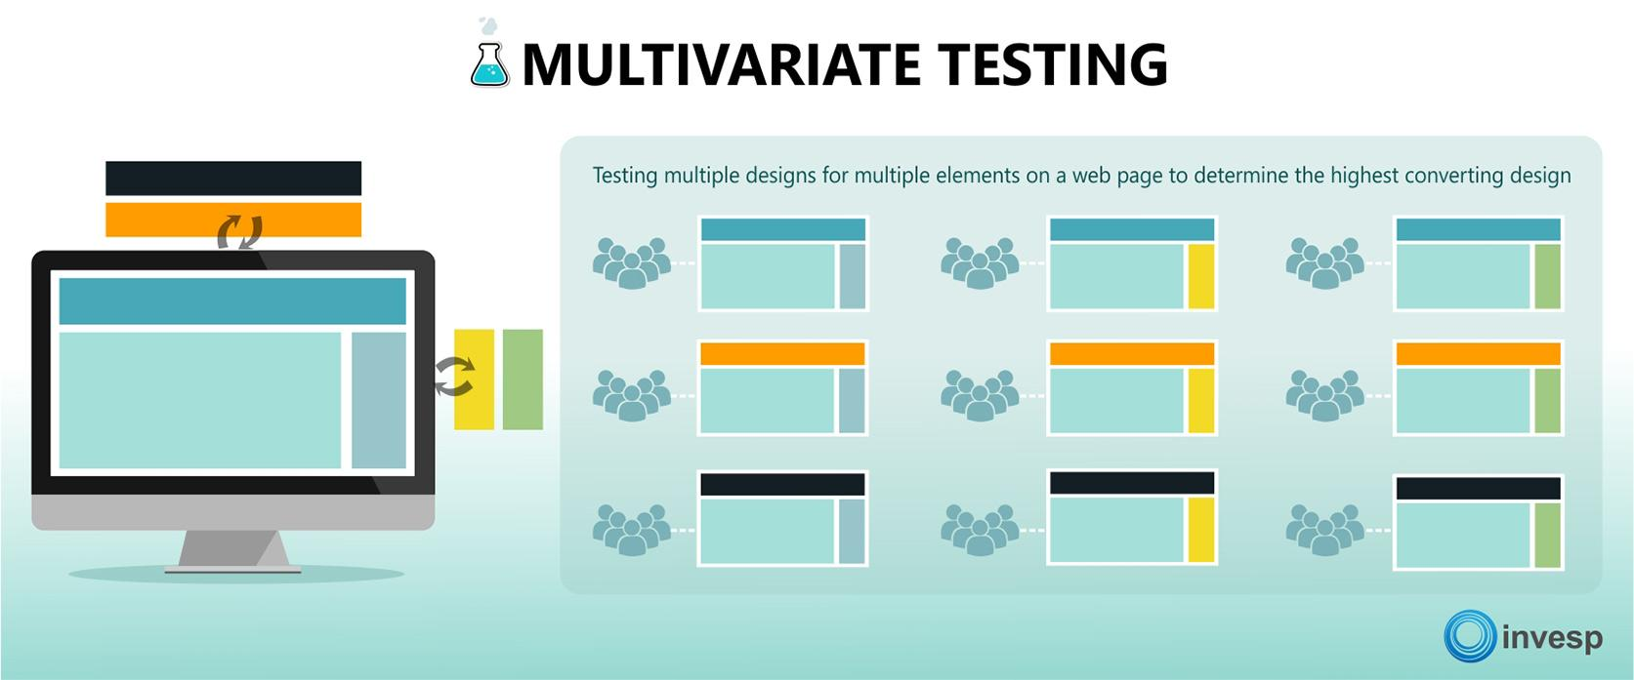
Multivariate testing is a process by which more than one component of a website may be tested in a live environment. It can be thought of in simple terms as numerous A/B test performed on one page at the same time.
WHAT IS MULTIVARIATE TESTING?

Slide 38
01
02
WHAT TYPES OF MULTIVARIATE TESTS ARE THERE?
Full Factorial
Fractional Factorial

Slide 39
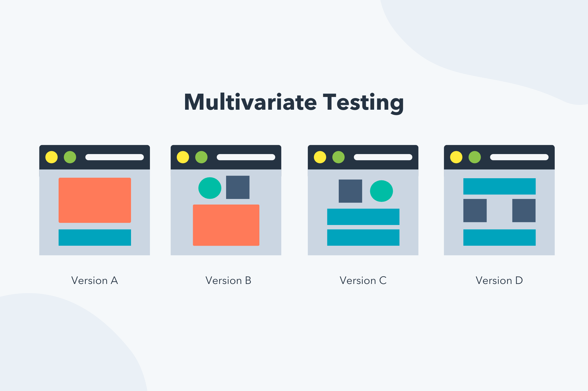
WHY RUN MULTIVARIATE TESTS?
01
02
03
Avoid performing successive A/B tests
Determine the impact of each variable
Measure the impact of interactions

Slide 40
HOW TO RUN A MULTIVARIATE TEST?
Identify a problem
Start driving traffic
Define your goals and formulate a hypothesis
Multivariate test
Review your test setup
Create variations
Determine your sample size

Slide 41
ADVANTAGES AND DISADVANTAGES
- Advantages: Multivariate testing is a powerful way to help you target redesign efforts to the elements of your page where they will have the most impact.
- Disadvantages: The single biggest limitation of multivariate testing is the amount of traffic needed to complete the test. Since all experiments are fully factorial, too many changing elements at once can quickly add up to a very large number of possible combinations that must be tested.

Slide 42
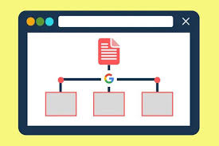
05
SITEMAP

Slide 43

WHAT IS SITEMAP?
Sitemap (system map of a website) is a text file that contains all the URLs of the website, specifically the system of links to the main page, the subpages are clearly represented. clear, circuit link.

Slide 44

FUNCTIONS OF SITEMAP
+ Provide valuable metadata associated with the websites you list in their sitemap. For example, when the page was last updated, how often the site was changed, or the importance of the pages relative to other links in the site.

Slide 45
SOME TYPES OF SITEMAPS
01
The structure
02
The form

Slide 46
Sitemap functions as a web map, and it is very necessary for your website to achieve a high position in the search system, because search engines tend to appreciate the website has a navigation map when accessing the website.
WHY DOES A WEBSITE NEED A SITEMAP?

Slide 47
HOW SHOULD THE SITEMAP BE DIVIDED?
01
02
03
04
Sitemap of articles
Video Sitemap
Sitemap Category
Photo Sitemap

Slide 48

06
GOOGLE ANALYTICS

Slide 49
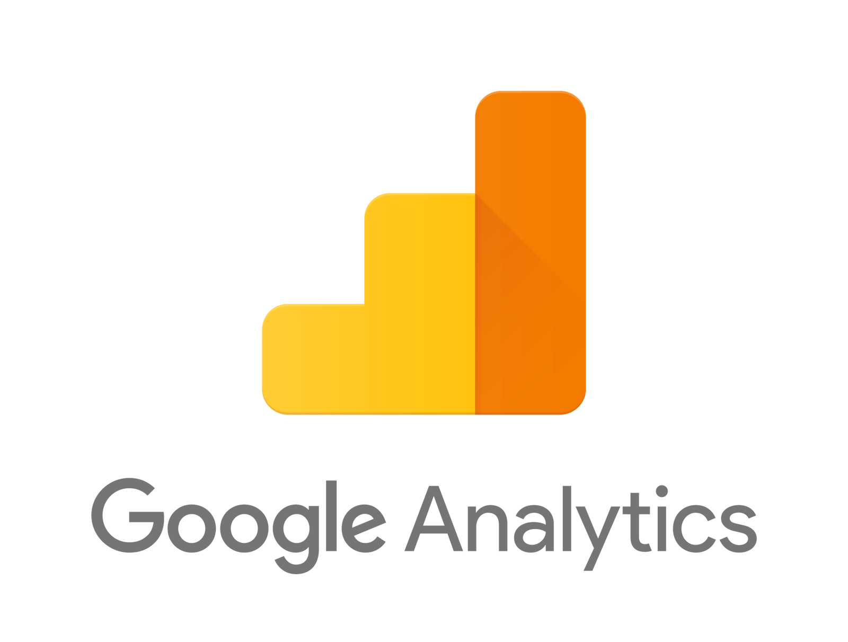
WHAT IS GOOGLE ANALYTICS?
Google Analytics is known as one of the most popular website performance measurement tools today.

Slide 50
HOW GOOGLE ANALYTICS WORK?
01
03
Data collection
Processing
02
04
Configuration
Reporting

Slide 51
SOME BASIC FUNCTIONS OF GOOGLE ANALYTICS
01
02
03
04
Real-time statistics support
Collect information about the user's language and device
Track users' habits on the website
Traffic analysis

Slide 52

Thanks you for listening our presentation

